Slide 1
^{Women’s}
^{Mental Health} ^{Training}
^{THINKING WELL,}
^{Living Well}
A Resource for Churches on Comprehensive Health Ministry

Slide 2
Understanding Mental Health
Written by
Elsie Staple
Notes:
This unit will identify the components of health, attempt to define mental health, identify the determinants of mental health and then consider some of the mental health conditions which can promote mental health wellbeing, including the self system.
“I wish above all that thou prosper and be in health even as thy soul prospereth.” (3 John 1) is God’s ideal for mankind. However, in our sin polluted environment, disease is inevitable. We are aware that degeneration can be swift and rapid. So how can one prosper and be in health? Let us first consider the question “What is health?”
It is important to note that health is wholistic and consists of many components. These are physical, emotional, spiritual, mental, sexual, environmental, and societal. These strands are closely related and deeply interconnected. Therefore ill health in one facet can have repercussions in another aspect of one’s health.

Slide 3
Mental Health Defined
Notes:
Mental Health Defined
Mental health is NOT mental illness! Mental health is not an absence of a mental disorder! When one considers the term ‘mental’ it often has a negative connotation. We frequently hear the phrase “You are mental!” but we are all mental beings with mental needs. Therefore, what is mental health?
Mental health is not easy to define because values differ across cultures as well as among subgroups (and indeed individuals) within a culture. Therefore, what it means to be mentally healthy is subject to many different interpretations which are rooted in value judgments that may vary across cultures.
Mental health is a concept that refers to a human individual's emotional and psychological well-being. It is the balance between all aspects of life - social, physical, spiritual and emotional. It impacts on how we manage our surroundings, make choices in our lives - and is an integral part of our overall health.
Webster’s dictionary defines mental health as "A state of emotional and psychological well-being in which an individual is able to use his or her cognitive and emotional capabilities, function in society, and meet the ordinary demands of everyday life."
Mental health is a state of well-being in which the individual realises his or her own abilities, can cope with the normal stresses of life, can work productively and fruitfully and is able to make a contribution to his or her community.
Mental health is the successful performance of mental function, resulting in productive activities, fulfilling relationships with other people and the ability to adapt to change and cope with adversity from early childhood until late life. Mental health is the springboard of thinking and communications skills, learning, emotional growth, resilience and self-esteem.
Mental health is the emotional and spiritual resilience which enables enjoyment of life and the ability to survive pain, disappointment and sadness; and as a positive sense of wellbeing and an underlying belief in our own and other’s dignity and worth.

Slide 4
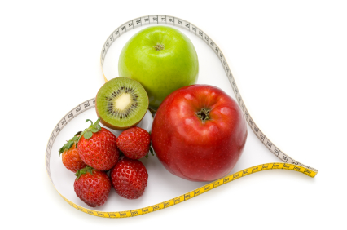
Mental Health Described
Psychological wellbeing
Psychosocial health
Psychosocial wellbeing
Wellness
Wellbeing
Positive mental health
Emotional health
Notes:
However mental health can be described in a variety of different but complementary ways. The terminology includes:
Psychological wellbeing
Psychosocial health
Psychosocial wellbeing
Wellness
Wellbeing
Positive mental health
Emotional health

Slide 5
The Determinants of Mental Health Promotion
Protective factors
Environmental | + | Self | + | Emotional | + | Self | + | Social Skills
quality |  | esteem |  | processing |  | management |  | participation
Risk factors
Environmental | + | Emotional | + | Emotional | + | Stress | + | Social
deprivation |  | abuse |  | negligence |  |  |  | exclusion
Notes:
The Determinants of Mental Health Promotion
According to MacDonald and O’Hara (1998) model there are 10 elements of mental health. These determinants range from individual to environmental factors and which pairs protective and risk factors to inform and design appropriate interventions. The determinants are:
Protective factors
[include] Environmental quality [and] Self esteem [and] Emotional processing [and] Self management [and] Social Skills participation
Risk factors
[include] Environmental deprivation[and] Emotional abuse[and] Emotional negligence[and] Stress[and] Social exclusion

Slide 6
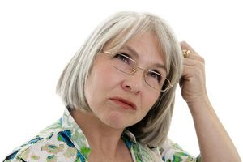
Mental Health Promotion
Individual (micro)
Communities (meso)
Government (macro)
Notes:
Mental Health Promotion
Mental health promotion involves actions that create living conditions and environments to support mental health and allow people to adopt and maintain
healthy lifestyles. This includes a range of actions that increase the chances of more people experiencing better mental health. Mental health promotion works from the principle that everyone has mental health needs, not just people who have been diagnosed with a mental illness.
Mental health promotion is essentially concerned with making changes to society that will promote people's mental wellbeing.
Mental health promotion is a term that covers a variety of strategies. These strategies can be seen to occur at three levels:
Individual (micro) - encouragement of individual resources by promotion of interventions for self-esteem, coping, assertiveness in areas such as parenting, the workplace or personal relationships.
Communities (meso) - increasing social inclusion and cohesion, developing support structures that promote mental health in workplaces, schools, churches and neighbourhoods.
Government (macro) reduces socioeconomic barriers to mental health at governmental level by promoting equal access for all and support for vulnerable citizens.

Slide 7
Positive Mental Wellbeing
A positive view of self
Personal growth and development
Autonomy
Accurate view of reality
Positive friendships
Environmental mastery
Notes:
Positive Mental Wellbeing
Positive mental wellbeing includes:
A positive view of self: self-awareness, self-esteem, self-acceptance.
Personal growth and development: developing talents and abilities to their full potential.
Autonomy: being capable of independent action.
Accurate view of reality: not distorting the world in any way.
Positive friendships: the ability to build relationships of many varieties.
Environmental mastery: meeting the requirements of the many different situations encountered in everyday life.

Slide 8
Characteristics of Mental Health
The Ability to Enjoy Life
Resilience
Balance
Notes:
Characteristics of Mental Health
The Ability to Enjoy Life - The ability to enjoy life is essential to good mental health. The practice of mindfulness meditation is one way to cultivate the ability to enjoy the present. We, of course, need to plan for the future at times and we also need to learn from the past. Too often we make ourselves miserable in the present by worrying about the future. We need to play and have fun.
Resilience - The ability to bounce back from adversity has been referred to as "resilience." The ability to face problems, resolve them and learn from them. It has long been known that some people handle stress better than others.
Balance - Balance in life seems to result in greater mental health. It creates an awareness of how the mind and body interact. Just as our state of mental health can affect our physical health, the reverse is also true. We all need to balance time spent socially with time spent alone, for example the use and enjoyment of solitude. Those who spend all of their time alone may get labelled as "loners" and they may lose many of their social skills. Extreme social isolation may even result in a split with reality. Those who ignore the need for some solitary times also risk such a split. Balancing these two needs seems to be the key – although we all balance these differently. Other areas where balance seems to be important include the balance between work and play, the balance between sleep and wakefulness, the balance between rest and exercise and even the balance between time spent indoors and time spent outdoors.

Slide 9
Characteristics of Mental Health
Flexibility
Self-actualization
Healthy Relationships
Notes:
Flexibility - We all know people who hold very rigid opinions. No amount of discussion can change their views. Such people often set themselves up for added stress by the rigid expectations that they hold. Working on making our expectations more flexible can improve our mental health. Emotional flexibility may be just as important as cognitive flexibility. Mentally healthy people experience a range of emotions and allow themselves to express these feelings. They are aware of what can go wrong. They have the ability to laugh both at themselves and at the world. Some people shut off certain feelings, finding them to be unacceptable. This emotional rigidity may result in other mental health problems.
Self-actualization - What have we made of the gifts that we have been given? We all know people who have surpassed their potential and others who seem to have squandered their gifts. We first need to recognize our gifts, of course and the process of recognition is part of the path toward self-actualization. Mentally healthy people spend time reviewing their lives from time to time. They consider what their goals in life are and what steps are being taken to achieve them. Mentally healthy persons are persons who are in the process of actualizing their potential. They develop emotionally, creatively, intellectually and spiritually. Problems can arise when we feel that life is not satisfying and fulfilling.
Healthy Relationships - The ability to form healthy relationships with others is necessary for mental wellbeing. Social contact, having contact with others whose company we enjoy, whether at school, at work, at home or as a member of a club, helps to develop social interaction. It aids initiation, development and maintenance of mutually satisfying personal relationships. This affects how we feel about other people. It engenders awareness and the capacity to empathise with them. It aids in the development of confidence and assertiveness and encourages healthy sexuality. It is important to have someone to go to with our problems and worries, such as friends, teachers or family members - someone we can trust.

Slide 10
Preventative Tips for Positive Mental Health
making time to do the things we enjoy
taking moderate physical exercise
cutting down on coffee, alcohol, nicotine and other addictive substances
remembering and celebrating the things we like about ourselves
keeping things in perspective
Notes:
Preventative Tips for Positive Mental Health
making time to do the things we enjoy
taking moderate physical exercise
cutting down on coffee, alcohol, nicotine and other addictive substances
remembering and celebrating the things we like about ourselves
keeping things in perspective

Slide 11
Preventative Tips for Positive Mental Health
developing and sustaining friendships
listening to and respecting other people, even if we disagree with them
asking for help if we feel distressed or upset
listening to other people who say they feel distressed or upset
taking as much care of ourselves as we do the people we care for
Notes:
developing and sustaining friendships
listening to and respecting other people, even if we disagree with them
asking for help if we feel distressed or upset
listening to other people who say they feel distressed or upset
taking as much care of ourselves as we do the people we care for

Slide 12
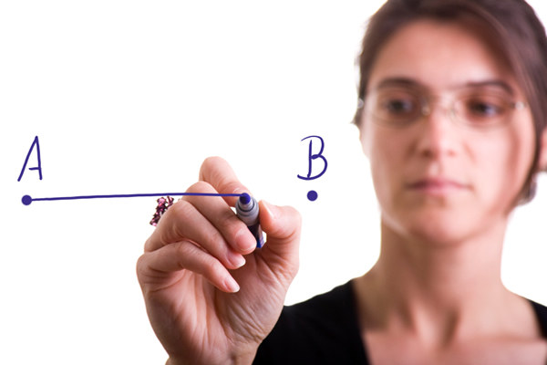
The Self-System
Self-image, self-concept, self-perception
Self-confidence, self-efficacy
Self-acceptance, self-worth, self-respect, self-esteem
Notes:
The Self-System
It is imperative for mental health to appreciate who you are and be honest with yourself. What are you really like? Are you both beauty and beast or wonderful and terrible? What are your strengths and limitations? The self-system is words which refer to attributes of the way we think, view and the value we place on ourselves. These are:
Self-image, self-concept, self-perception - all refer to the overall picture a person has of him or herself
Self-confidence, self-efficacy - suggests one’s ability to perform
Self-acceptance, self-worth, self-respect, self-esteem - they imply judgment, value and evaluation of oneself

Slide 13
The Self-System
Some aspects of Low Self-Esteem
Expect people to be critical of them
Are passive or obstructive self agents
Have negative perceptions of their skills, appearance, sexuality and behaviours
Perform less well when being watched
Some aspects of High Self-Esteem
Are active self-agents
Have positive perception of their skills, appearance, sexuality and behaviours
Perform equally well when being observed as when not watched
Notes:
People with low self-esteem
Expect people to be critical of them
Are passive or obstructive self-agents
Have negative perceptions of their skills, appearance, sexuality and behaviours
Perform less well when being watched
People with high self-esteem
Are active self agents
Have positive perception of their skills, appearance, sexuality and behaviours
Perform equally well when being observed as when not watched

Slide 14
The Self System
Some aspects of Low Self-Esteem
Are defensive and passive in response to criticism
Have unrealistic expectation about their performance
Are dissatisfied with their lot in life
Have a weak social support system
Have difficulty accepting compliments
Some aspects of High Self-Esteem
Are non-defensive and assertive in response to criticism
Evaluate their performance realistically
Express general satisfaction in life
Have a strong social support network
Can accept compliments easily
Notes:
People with low self esteem
Are defensive and passive in response to criticism
Have unrealistic expectations about their performance
Are dissatisfied with their lot in life
Have a weak social support system
Have difficulty accepting compliments
People with high self esteem
Are non-defensive and assertive in response to criticism
Evaluate their performance realistically
Express general satisfaction with life
Have a strong social support network
Can accept compliments easily

Slide 15
God’s Word and Our True Selves
For we are God’s handiwork, created in Christ Jesus to do good works, which God prepared in advance for us to do.
Ephesians 2:10 (NIV)
Notes:
We can only get over of our problem of lack of self-esteem if we set out to care for both ourselves and others.
The only proper mirror for seeing our true selves is God’s word.
Discover:
We are God’s art work: So God created mankind in his own image, in the image of God he created them; male and female he created them. Genesis 1:27 (NIV)
What God intends to become: For we are God’s handiwork, created in Christ Jesus to do good works, which God prepared in advance for us to do. Ephesians 2:10 (NIV)
Love and accepted unconditionally: Therefore, there is now no condemnation for those who are in Christ Jesus. Romans 8:1 (NIV)

Slide 16
Prayer
“Dear friend, I pray that you may enjoy good health and that all may go well with you, even as your soul is getting along well.”
3 John 1:2
Notes:
Prayer
“Dear friend, I pray that you may enjoy good health and that all may go well with you, even as your soul is getting along well.” 3 John 1:2

